Slide 1

HEP Weekly Report
George Bakas
NTUA

Slide 2
Status Report
Working on the MoxaE1240 Harware Component
SNMP Communication Protocol
Uses an OID to connect each channel
Uses some kind of counter that is received by WinCC and is then converted to a Voltage and sometimes a temperature which can is plotted and archived
User can configure and monitor the hardware from the Device Editor Navigator
Possibility to save all the configurations to the database

Slide 3
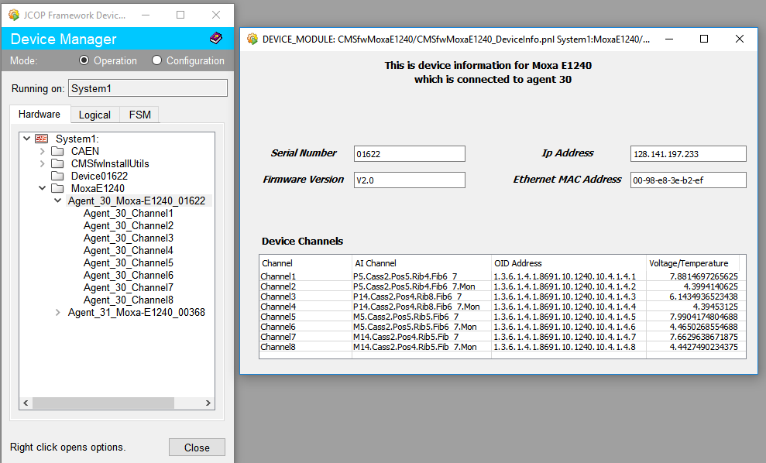

Slide 4
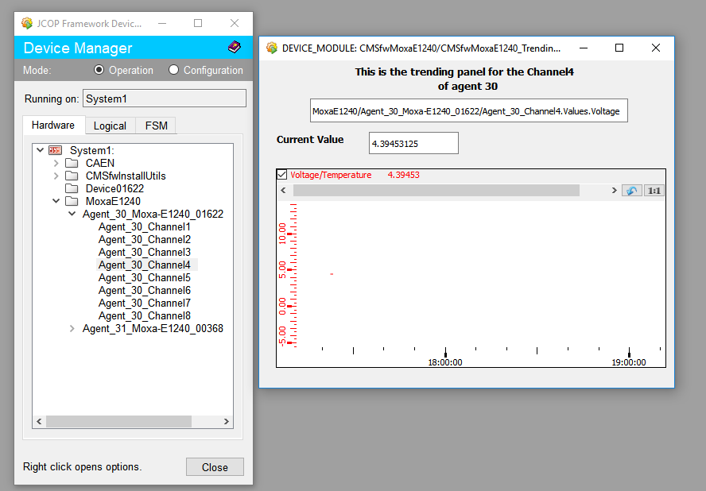

Slide 5
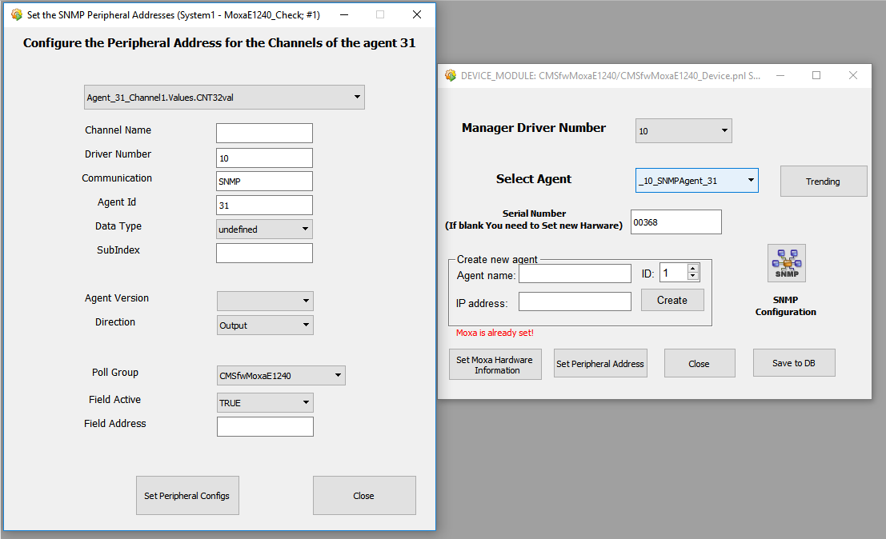

Slide 6
CMSfwInstallUtils Save to configuration DB and check consistencies panels
Here the user can check the device List that is to be saved on database or it is already saved on the database
These panels give the ability to check for all datapoint elements whatever is missing either from project or from the database
Also checks each config (address, alerts, etc) individually for each datapoint element and does the same procedure
There are three possible outcomes
Consistent: This means that everything is ok
Inconsistent: This means that config was found on the dpe in the db and in the project but it wasn’t exactly the same
Missing: Either missing from database or from project
Missing and inconsistent: Found some inconsistend dpe’s as well as missing dpe’s
When missing or inconsistency is found→ the user can right click and an information panel opens with more info for the datapoint elements that have problem

Slide 7
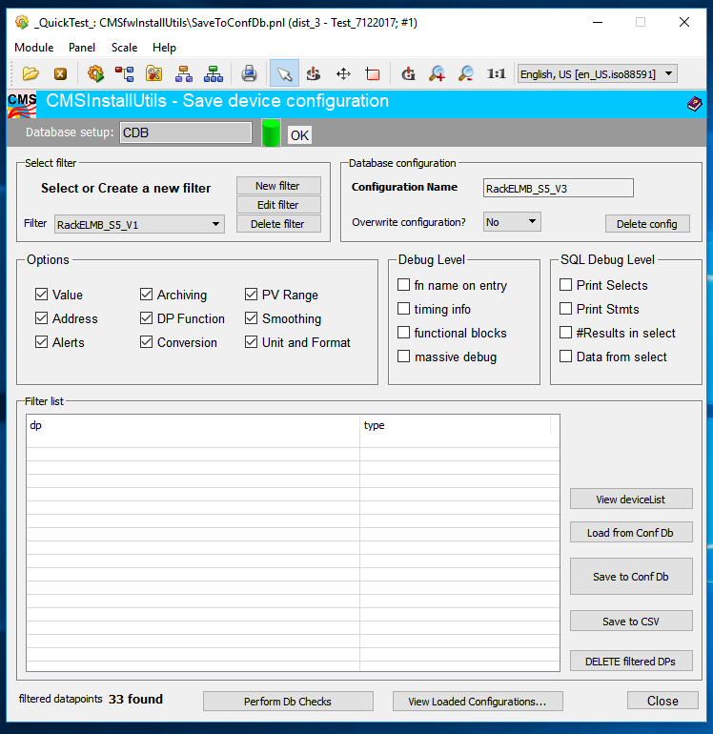

Slide 8
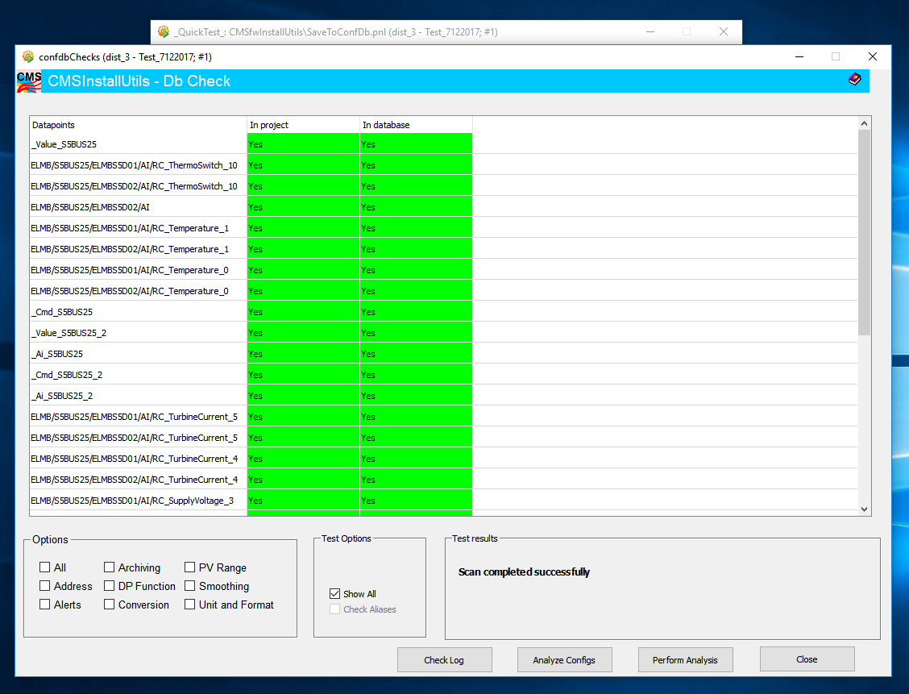

Slide 9
